Slide 1


Brightlight Coffee Shop
Sales & Performance Analysis
Business Insights Report
October 30, 2025
By R.F Chauke

Slide 2




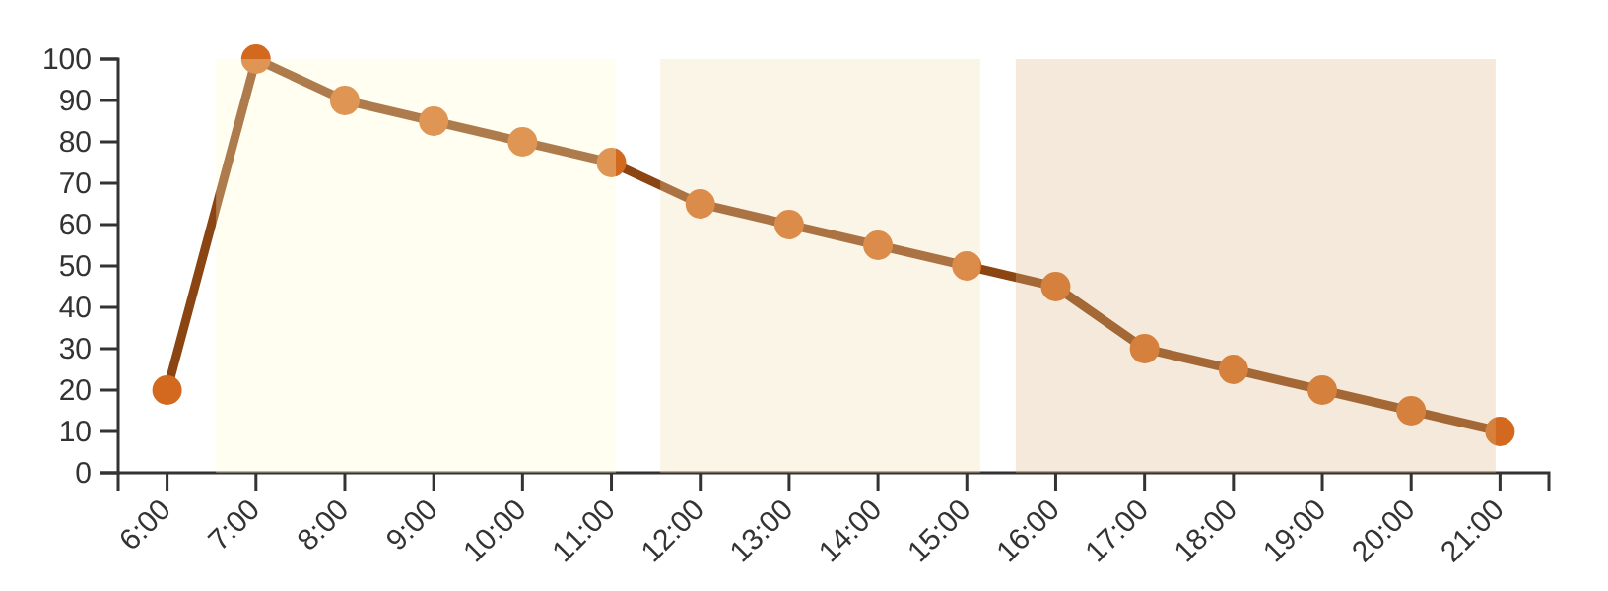



Executive Summary
Peak Hours
Transaction Pattern Visualization
Morning rush from 07:00–11:00 drives most sales
Steady midday sales between 12:00–15:00
Decline after 16:00 with evening hours underperforming
Weekday Performance
Highest revenue on Friday, followed by Thursday
Moderate performance on Saturday
Lowest on Sunday
Key Insight
Location Analysis
"Focus on morning operations; introduce promotions to stimulate afternoon and evening demand."
A few locations generate most of total revenue
Urban stores outperform suburban outlets
Brightlight Coffee Shop | Sales & Performance Analysis

Slide 3


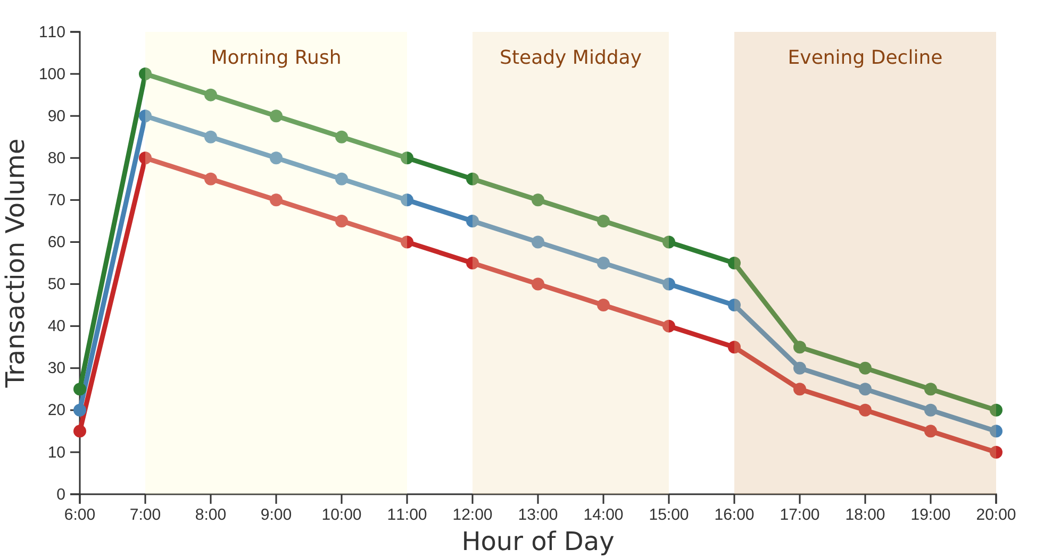










Transaction Patterns by Hour
Key Patterns
Transaction Volume by Hour of Day
Morning rush from 07:00–11:00 drives most sales
Steady midday sales between 12:00–15:00
Decline after 16:00 with evening hours underperforming
Strategic Recommendations
Optimize morning operations to maximize peak hours
Introduce promotions to stimulate afternoon demand
Create evening special offers to combat decline
Astoria
Hell's Kitchen
Lower Manhattan
Brightlight Coffee Shop | Sales & Performance Analysis

Slide 4



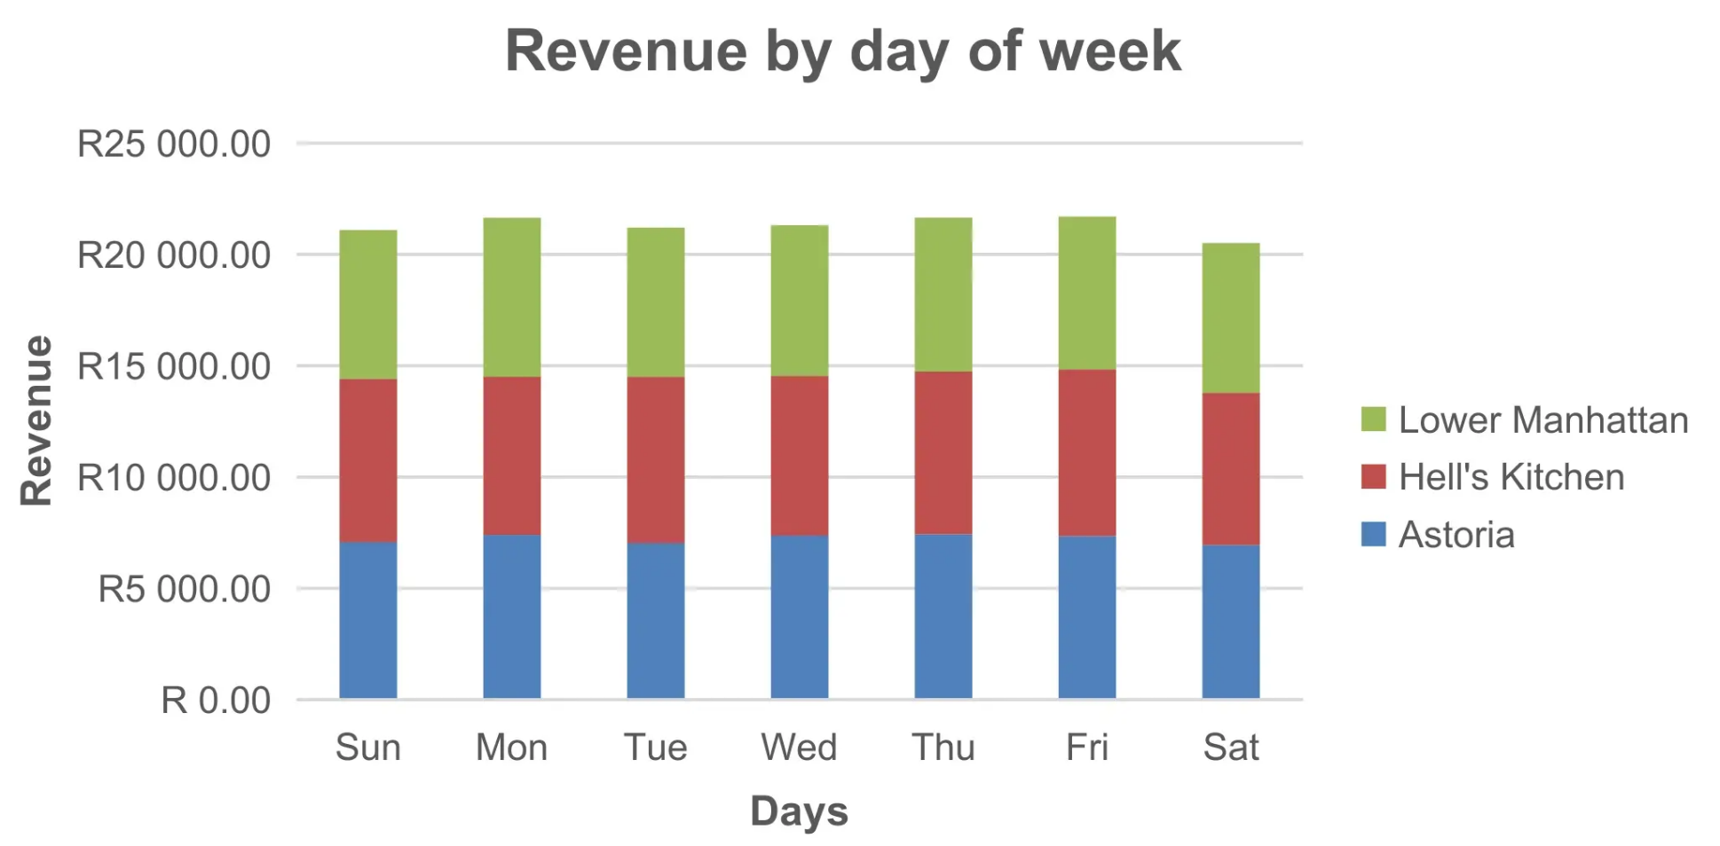





Revenue Performance by Day of Week
Key Findings
Daily Revenue Distribution
Friday
Highest revenue day of the week
Thursday
Second highest revenue day
Sunday
Lowest revenue among all days
Weekday Dominance
Tuesday-Thursday show steady sales
Business Insight
Weekday sales dominate revenue; introduce weekend-exclusive promotions to balance weekly revenue.
Chart shows revenue distribution across three locations: Astoria, Hell's Kitchen, and Lower Manhattan
Brightlight Coffee Shop | Sales & Performance Analysis

Slide 5

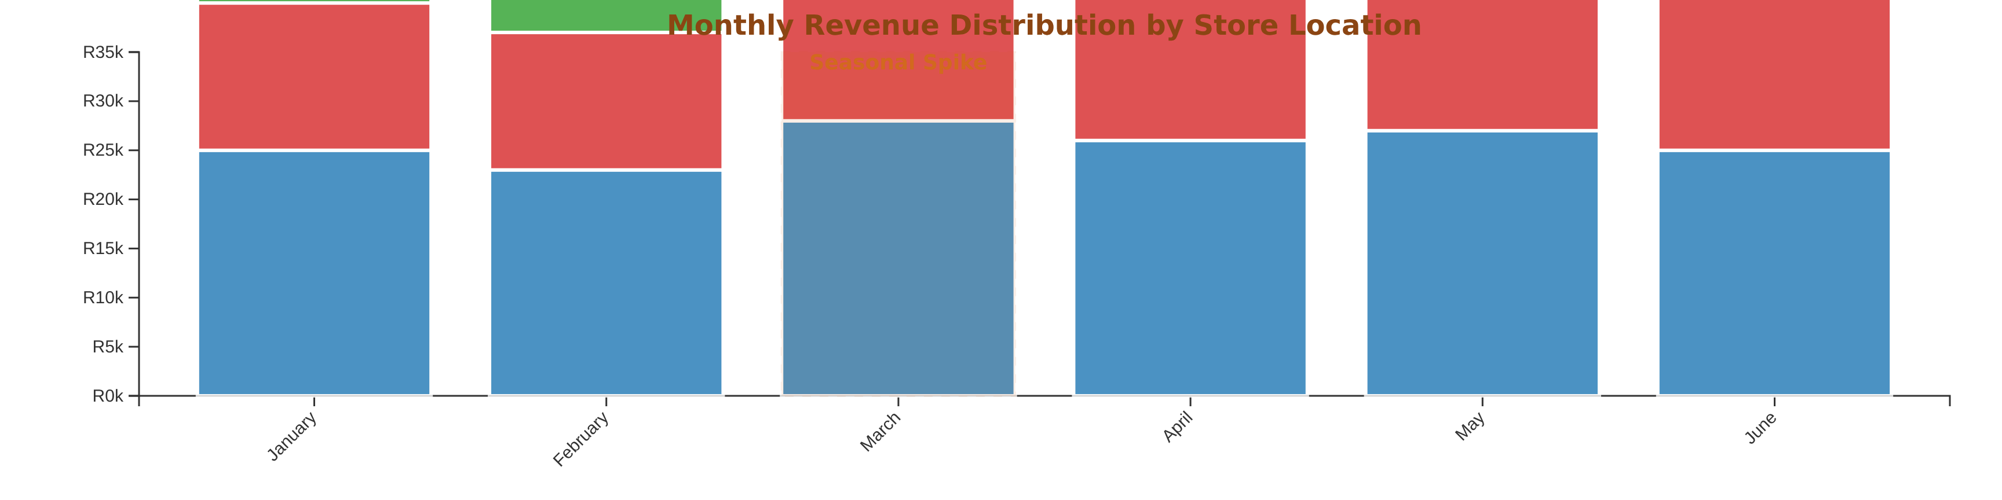









Monthly Revenue by Store Location
Astoria
Hell's Kitchen
Lower Manhattan
Top Performers
Seasonal Spikes
Action Items
Astoria and Lower Manhattan outperform others
Revenue surges in December and March
Replicate top-performing store strategies
Brightlight Coffee Shop | Sales & Performance Analysis

Slide 6








Top-Selling Product Categories
Revenue Anchor
Product Category Performance
Hot coffee beverages remain the anchor of revenue, underscoring preference for espresso-based products.
Growth Potential
Iced and blended drinks offer growth potential, especially in summer hours.
Strategic Opportunity
Expand afternoon offerings with iced beverages to capture declining morning market.
"Optimize staffing based on hourly demand."
Brightlight Coffee Shop | Sales & Performance Analysis

Slide 7


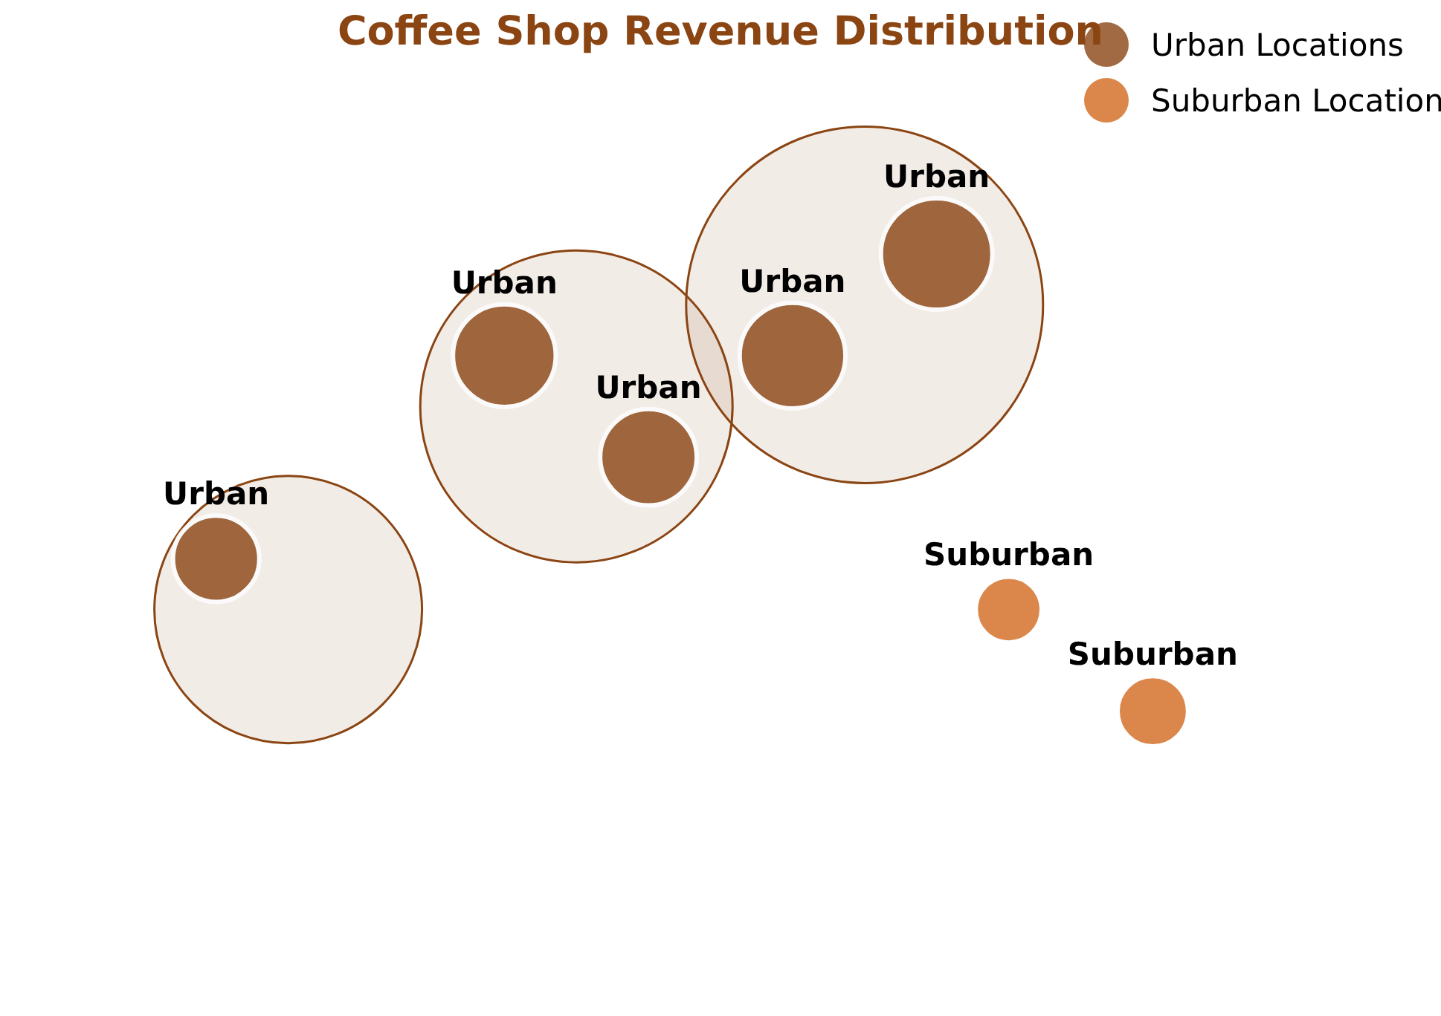


Revenue Distribution Across Locations
Key Insights
A few locations generate most of total revenue
Urban stores outperform suburban outlets
Hell's Kitchen shows strongest performance
Strategic Implications
"Diversify revenue sources and increase brand presence in lower-performing regions."
Brightlight Coffee Shop | Sales & Performance Analysis

Slide 8


















Strategic Recommendations
Implement 'Happy Hour' Deals
Weekend-Exclusive Promotions
Introduce limited-time discounts in the afternoon and evening to boost otherwise slow transaction periods.
Create special offers available only on weekends to encourage customers to visit during previously underperforming periods.
Standardize High-Performing Practices
Optimize Staffing by Hour
Adjust staffing levels according to hourly transaction volumes to improve efficiency during peak morning hours.
Identify and implement successful operational procedures from top-performing stores across all locations.
Targeted Marketing for Lower-Performing Stores
Develop location-specific marketing strategies to address unique challenges and capitalize on opportunities in underperforming regions.
Brightlight Coffee Shop | Sales & Performance Analysis

Slide 9














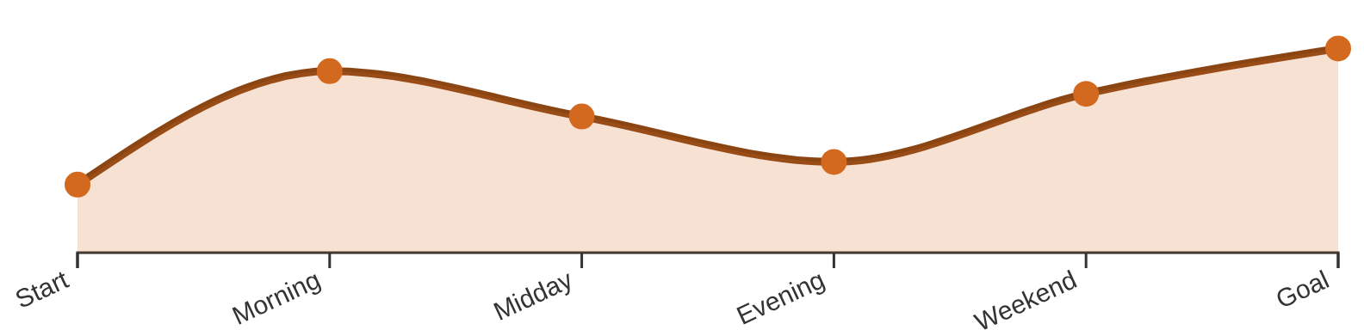

Conclusion & Next Steps
Key Findings
Next Steps
Strong weekday and morning sales form a stable business foundation
Implement 'Happy Hour' deals
Boost afternoon and evening trade
Morning rush (7-11am) drives most transactions
Launch weekend-exclusive promotions
Weekdays dominate revenue; weekend sales underperform
Balance weekly revenue
Urban stores outperform suburban outlets
Standardize high-performing practices
Replicate success across stores
Balanced Growth Strategy
Optimize staffing
Match hours to demand patterns
Brightlight Coffee Shop | Sales & Performance Analysis

